Slide 1

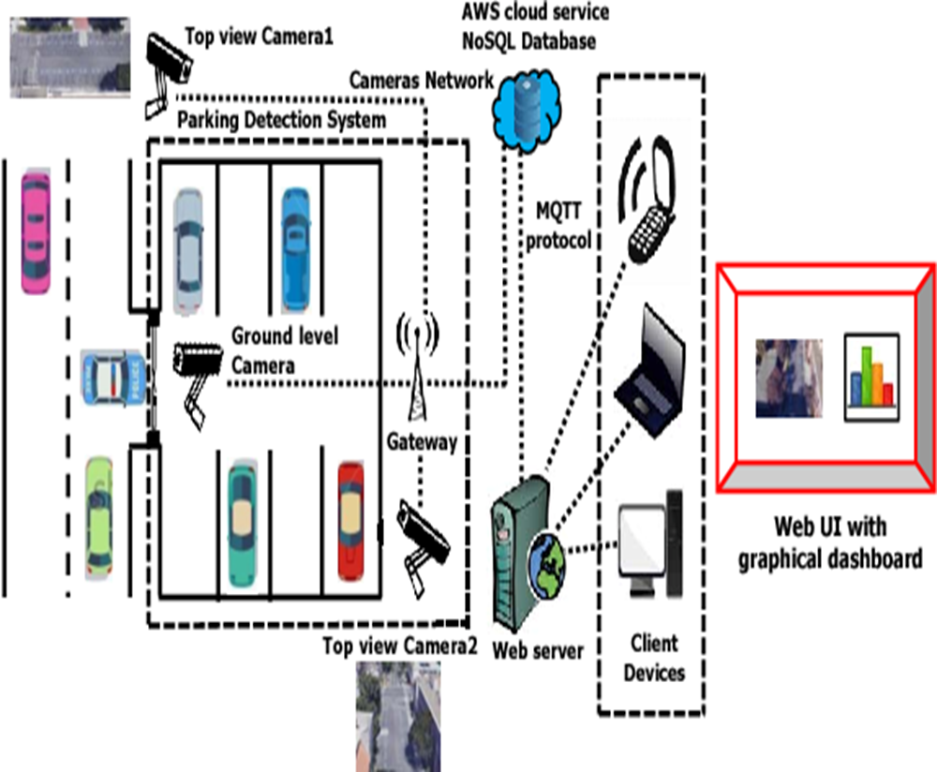
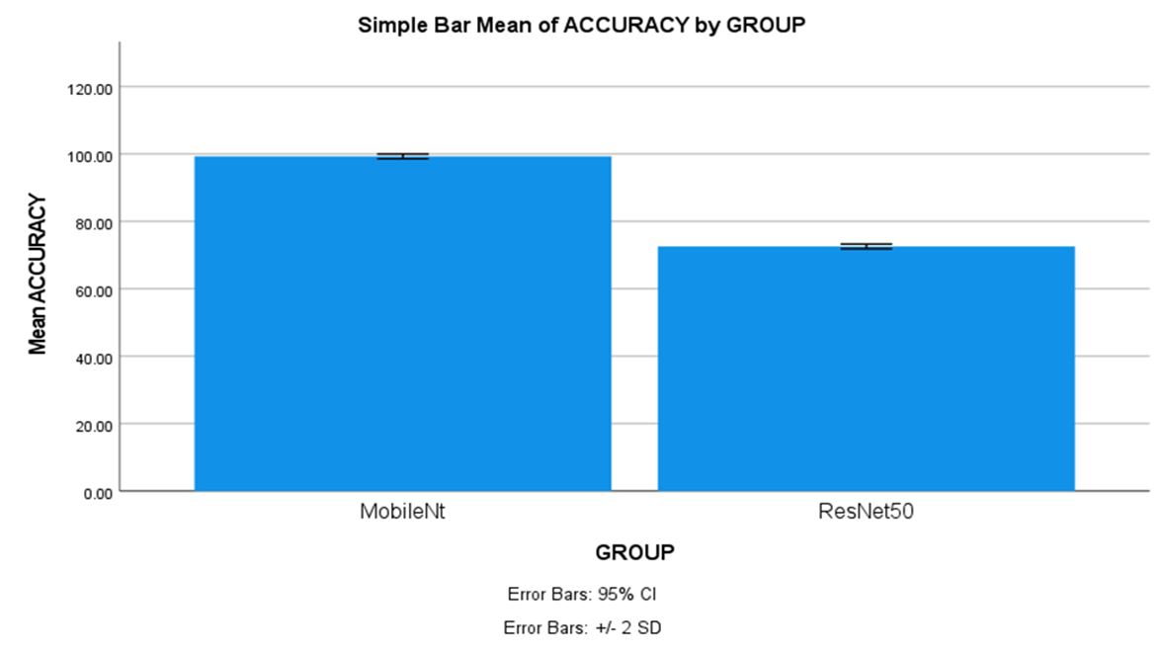
Name: N.S Lakshmi Charith Register Number: 192111138
Guided by Dr. S.Sankar
Ms. Poorani.S
Guided by Dr. Mary Valantina. G
Efficient Smart Parking System Using ResNet-50 Algorithm Comparing with MobileNet-V2 Algorithm
INTRODUCTION
Cities are getting more crowded, and parking is becoming a nightmare. Smart parking systems can help by using technology to make better use of parking spaces. These systems use advanced algorithms like to keep track of parking in real time and especially good at figuring out where cars parking spot is open, space usage, reducing traffic and decreasing carbon emissions.
The aim of this study is to classify real-time processing and decision-making, ensuring quick and accurate identification of available parking spaces by using two deep learning algorithms.
In this research study, MobileNetV-2 algorithm is compared with ResNet-50 algorithm to enhance accuracy. MobileNet-V2 has a more straightforward architecture with stacked convolutional layers, better suited for capturing the visual features of the parking spots. ResNet-50 will handle complex visual data like image classification and object detection makes it a versatile tool for computer vision applications.
The research will employ a diverse dataset of car parking images encompassing various spaces to evaluate the effectiveness of car parking identification algorithms.
MATERIALS AND METHODS
The Research work is carried out MobileNet-V2 Algorithm is in Group 1 and Group 2 is compared of ResNet-50 algorithm. The sample size is given to each group 10 times.
Alpha, Beta, G-Power, CI and threshold values for the study are 0.05, 0.2, 0.8 and 95% respectively.
The Dataset is Made up of Images, there were 5000 images in this particular dataset. The dataset includes details of occupied and un occupied parking spaces and different size of vehicles.
A testing setup called both hardware and software configurations with windows compatibility.
SPSS tool is used for calculating t-test values. Independent and dependent variables were considered.
System Initialization
Acquiring Reference Image
Image Enhancement
Identifying Parking Space
Checks Availability
Acquiring Image (with Cars)
Coordinates Parking Area
Display Output
RESULTS
The MobileNet-V2 algorithm accuracy is 97% and accuracy for ResNet-50 algorithm is 72.50%.
The Mean accuracy of the MobileNet-V2 algorithm is 97%, with a standard deviation of 0.30%. For ResNet-50, the mean accuracy and standard deviation are 72.50% and 0.50 respectively.
Group |  | N | Mean | Standard Deviation | Standard Error Mean
Accuracy rate | MobileNetv | 10 | 97.4500 | .30277 | .09574
 | ResNet-50 | 10 | 72.4500 | .30277 | .09574
DISCUSSION AND CONCLUSION
Based on obtained results, MobileNet-V2 has significantly better accuracy (97%) compared to ResNet-50Algorithm accuracy (72.50%).
The Independent samples T-test revealed a statistically significant difference value of (p=0.013) (independent sample T - test p<0.05) is obtained and shows that there is a statistical significant difference between the group 1 and group 2.
In this study, the main contributors are vehicles and parking spaces. The MobileNet-V2 algorithm demonstrates an accuracy rate of 97%, outperforming ResNet-50, which achieves 72% accuracy. This findings revealed that MobileNet-V2 achieved higher accuracy in classifying images compared to ResNet-50 algorithm.
This research has identified that smart parking is evolving from simply finding an empty spot to navigate cities, and managing our resources with efficiency and sustainability with advancements in automation and vehicle integration.
From the work , it is concluded that the MobileNet-V2 algorithm attains high accuracy. MobileNet-V2’s ability to run efficiently on devices with good accuracy makes it a strong foundation for future advancements in embedded applications, medical diagnosis and wearable tech.
BIBLIOGRAPHY
Hayawi, D. Mustafad Mustafa J. Hayawi J., and Satar Shaker Muhammad. 2022. “Detection Parking Spaces by Using the ResNet50 Algorithm.” Journal of Al-Qadisiyah for Computer Science and Mathematics 14 (2). https://doi.org/10.29304/jqcm.2022.14.2.932.
Paidi, Vijay, Hasan Fleyeh, and Roger G. Nyberg. 2020. “Deep Learning‐based Vehicle Occupancy Detection in an Open Parking Lot Using Thermal Camera.” IET Intelligent Transport Systems 14 (10): 1295–1302.
Peng, Xinggan, Rongzihan Song, Qi Cao, Yue Li, Dongshun Cui, Xiaofan Jia, Zhiping Lin, and Guang-Bin Huang. 2022. “Real-Time Illegal Parking Detection Algorithm in Urban Environments.” IEEE Transactions on Intelligent Transportation Systems 23 (11): 20572–87.
Taylor, Onate, P. S. Ezekiel, and V. T. Emmah. 2021. “Smart Vehicle Parking System Using Computer Vision and Internet of Things (IoT).” European Journal of Information Technologies and Computer Science 1 (2): 11–16.
Wang, Li, Xinyu Zhang, Weijia Zeng, Wei Liu, Lei Yang, Jun Li, and Huaping Liu. 2023. “Global Perception-Based Robust Parking Space Detection Using a Low-Cost Camera.” IEEE Transactions on Intelligent Vehicles 8 (2): 1439–48.

